Slide 1
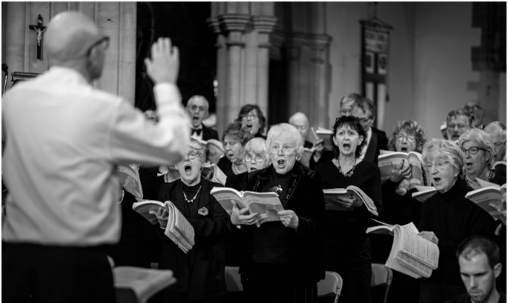
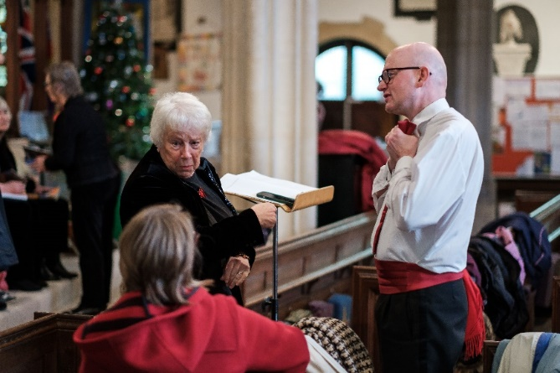
Wincanton Choral Society
Choral Workshop
Haydn’s - The Creation
Conductor: Neil Moore. Accompanist: Jacquelyn Bevan
Saturday 24th February 2024, 10.00 am – 16.00 pm
King Arthur’s School, Wincanton, BA9 9BX
Tickets £20, Music hire £3.00 (New Novello Choral edition)
For further information and an application form please contact honsecretary.wcs@gmail.com or tel. 07914 074198
includes tea, coffee & cakes etc. - LUNCH NOT INCLUDED.
Anyone who enjoys choral music is invited to join us for this exciting all day event. Singers will explore sections of Joseph Haydn’s dramatic work, which will provide an insight on what it is like to perform this major choral masterpiece.
The day will conclude with an informal run though to which friends and family are welcome to attend, free of charge.

